Slide 1

NIGHT VISION TECHNOLOGY
By ARIJIT DALUI

Slide 2

TABLE OF CONTENTS
INTRODUCTION
HISTORY
TYPES OF NIGHT VISION
WORKING OF TECHNICAL NIGHT VISION
NIGHT VISION DEVICES
GENERATIONS
APPLICATION
CONCLUSION
REFERENCE

Slide 3
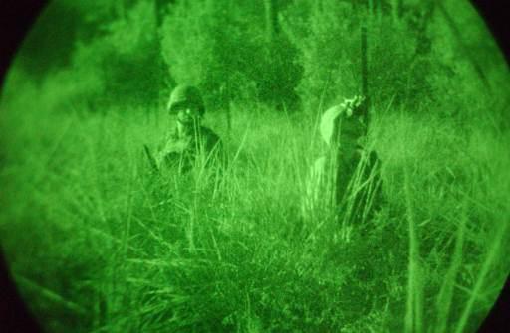
INTRODUCTION
Night vision is the ability to see in low light conditions.
Humans have poor night vision compared to many other animals.
With quality night vision goggles and scopes you can see people, animals, and objects up to 1,000 yards away on a dark night.
It is originally developed for military use.

Slide 4
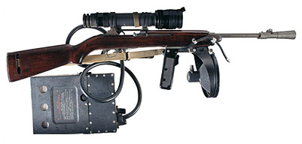
HISTORY
The first night vision devices (Gen 0) were introduced by the German army as early as 1939. By the end of World War II, the German army had equipped approximately 50 Panther tanks with night optics.
Source- https://www.nightvision.com.au/the-history-of-night-vision-technology
M2 Sniperscope

Slide 5
Contd…
Pre 1940’s:Flares and spotlights were used for operations at night.
Due to the nature of these early night vision devices (NVD),they gave away tactical positions.
Military Scientists began to think of ways to improve night vision to gain a strategic advantage.

Slide 6
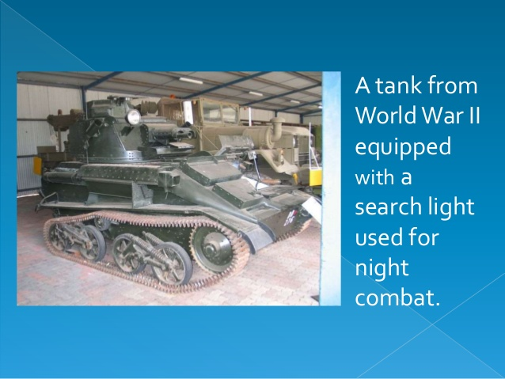
Source-https://www.google.com

Slide 7
TYPES OF NIGHT VISION
BROADLY CLASSIFIED INTO THREE MAIN TYPES
Image intensifier night vision
Digital night vision
Thermal imagers

Slide 8
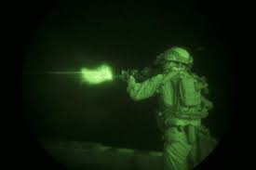
WORKING Of TECHNICAL NIGHT VISION
Technical night vision can work in two different ways.
Image Intensifier
Dim light from a night scene enters the lens at the front. The light is made of photons (particles of light) of all colors.
As the photons enter the goggles, they strike a light-sensitive surface called a photocathode. it's job is to convert photons into electrons.
The electrons are amplified by a micro channel plate, a kind of photoelectric cell. Each electron entering results in many more electrons leaving it.

Slide 9
CONTD……
The electrons leaving the microchannel plate hit a phosphor screen.
The energy of electrons release photons and create green image on the screen.
The green phosphor image is viewed through another lens.

Slide 10
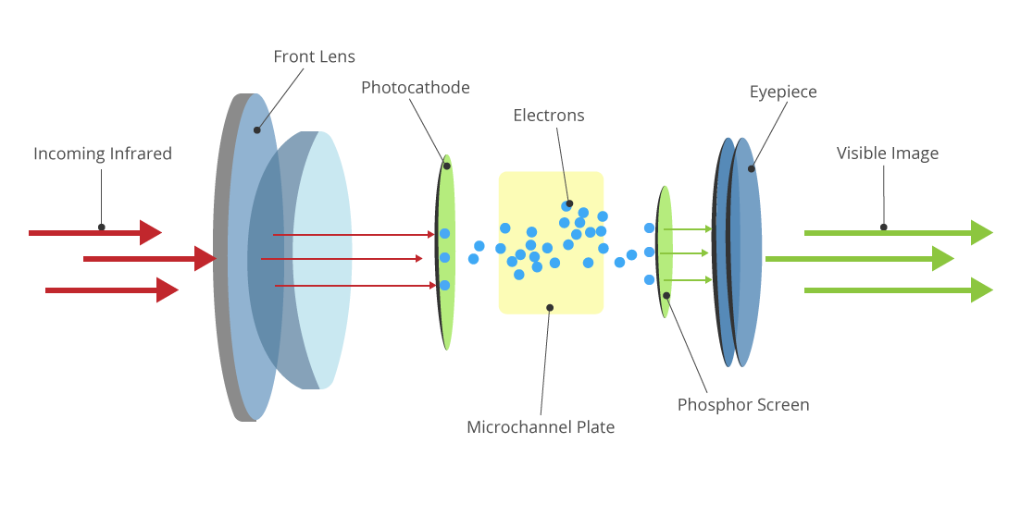
CONTD….
Source-https://www.google.com/url?sa=i&url=https%3A%2F%2Fwww.bhphotovideo.com%2Fexplora%2Foutdoors%2Fbuying-guide%2Fnight-vision-101-seeing-dark&psig=AOvVaw2Ch1-nSTZPm3ZcPRMu8WFi&ust=1609473271758000&source=images&cd=vfe&ved=0CAMQjB1qFwoTCPiQiaep9-0CFQAAAAAdAAAAABAD
PICTORIAL REPRESENTATION

Slide 11
THERMAL IMAGING
Any object with a temperature above absolute zero degrees Kelvin emits long-wave infrared light (heat).
The warmer the object is, the more infrared it radiates and the more detectable it is with thermal imaging.
They read the difference in temperature between an object and its background to create a thermal profile of the scene, which is then shown on an electronic display.
Thermal imagers usually use germanium optics, which are opaque to visible or near-infrared light and will not detect it.

Slide 12
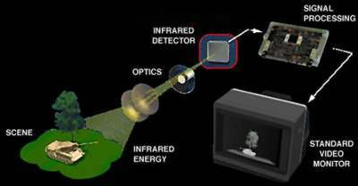
CONTD….
Source-www.nightvision.com

Slide 13
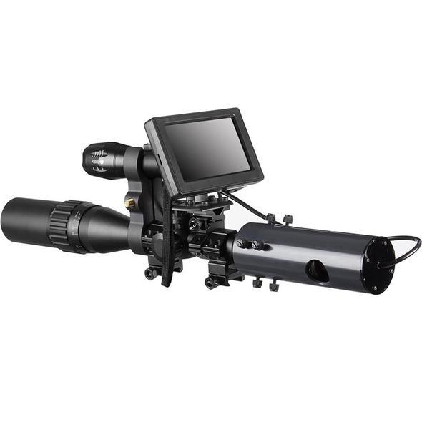
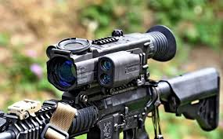
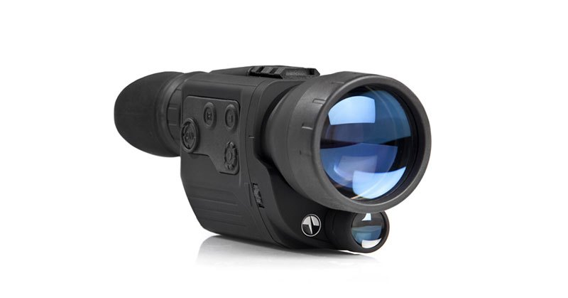
NIGHT VISION DEVICES
SCOPES-Perhaps the most popular consumer user of night vision technology can be found in scopes. Scopes can be either freestanding (handheld) or mounted onto certain types of firearms, such as rifles. Night vision scopes can be monocular (a single eyepiece) or binocular (two eyepieces for a stereoscopic image).
Source- www.cleverhunters.com

Slide 14
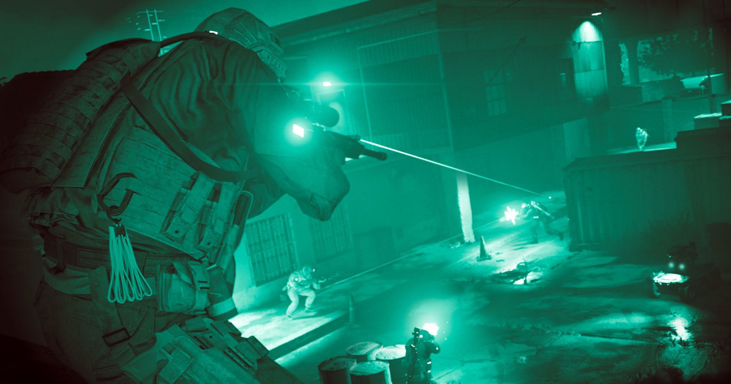
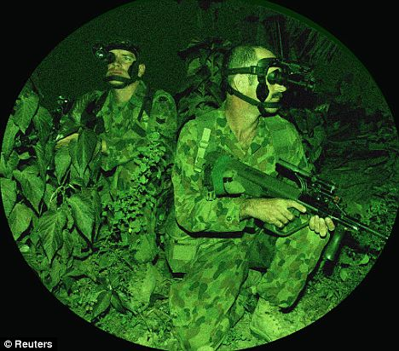
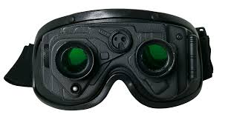
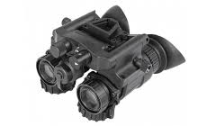
CONTD…..
GOGGLES-Night vision goggles use thermal imaging technology to capture that infrared light. This way, you can see an image of what’s going on in the dark. It’s based on the amount of heat being made by objects.
Source-https://www.google.com/Fnakedsecurity.sophos

Slide 15
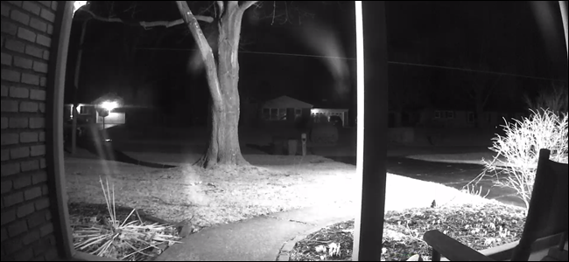
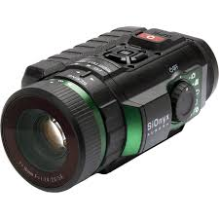
CONTD……
Cameras-Used for transmission or recording of images mostly if the location is fixed.
NIGHT VISION THROUGH A WINDOW

Slide 16
GENERATIONS
GENERATION-1:
It gets you some night time capability and remember some night vision is always better than no night vision. Is it the latest and greatest? No, in fact Generation 1 technology dates back to the early 1960's. That's when a computer was the size of a small house and cell phones were not even invented yet.
maximum useful range is about 75 yards.
lower resolution images
inability to operate "passively" - Gen 1 relies on built-in IR illuminators that are always on, making the user very visible to anyone using another night vision device.
shorter life expectancy. Gen 1: about 1500 hours.
shorter battery life.
smaller field of view due to distorted image on outer one third of the field of view.

Slide 17
Generation 2:
In a nutshell Gen 2 is a huge step up from 1st generation equipment.
much longer useful range, in the 200 yard area depending on model.
better resolution, cleaner images, brighter.
full field of view- no distorted image on outer one third of viewing area.
longer battery life
Life expectancy;Gen 2: about 5000 hours

Slide 18
Generation 3:
Gen 3 Autogated is what the US Military and Special Forces use and it is currently the gold standard in technology. There are several grades/levels of Gen 3, however they are all outstanding.
longest ranges, in the 300 yard plus range depending on model and conditions.
best resolution, cleanest and brightest images.
best low-light performance.
longest life expectancy of 10,000+ hours and best reliability/durability.

Slide 19



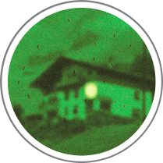
GENERATION 4:
This is a tricky one as technically there is not really a Gen 4 classification. When it was initially introduced the US Army recognized the Gen 4 technology classification. However, after testing reliability and life span of the Gen 4 the Army determined that this technology did not meet their strict requirements and thus rejected the Gen 4 definition. Now some companies use the 'Gen 4' Term as a marketing strategy to say its the best image.
GEN-1
GEN-2
GEN-3
GEN-4
SOURCE-www.nightvisionguys.com

Slide 20
APPLICATION
MILITARY
HUNTING
WILDLIFE OBSERVATION
SECURITY
HIDDEN OBJECT DETECTION

Slide 21

CONTD…
Source- PC game : call of duty modern warfare.

Slide 22
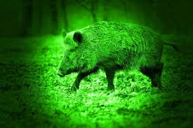
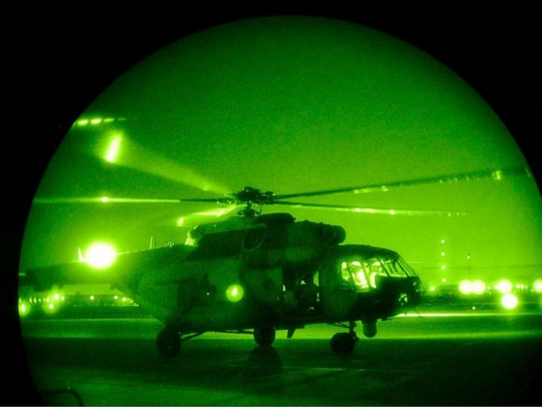
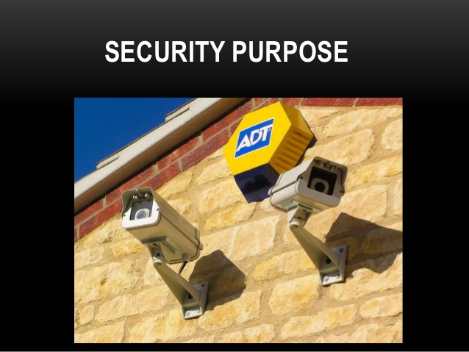
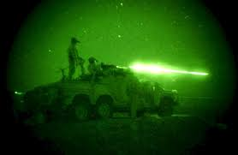
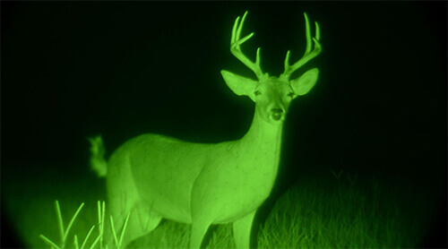
CONTD…..
Hunting
Military
Wildlife Observation

Slide 23
CONCLUSION
Night vision was originally developed for warfare. Information becomes even more valuable when lives literally depend on it, and the locations of enemy troops and awareness of your own surroundings are two of the most important types of information. The ability to gather this information at night, when your enemies may be blind, is a huge advantage.
Today in 21st century we have come a long way in the development of night vision technology, from the early 1940s.

Slide 24
REFERENCES
https://www.geeksforgeeks.org/night-vision-technology/#:~:text=Night%20vision%20technology%20works%20in,light%20and%20then%20amplify%20it.
https://en.wikipedia.org/wiki/Night_vision
https://www.dhs.gov/sites/default/files/publications/NV-Tech-HB_1013-508.pdf
https://whatis.techtarget.com/definition/night-vision
https://www.asc.ohio-state.edu/perry.6/p596_au99/Samples/shortmed/johnmedium/index.html

Slide 25

THANK
YOU

